Slide 1



Lessons Learned from Developing Automated Machine Learning on HPC
Romain EGELE
romain.egele@universite-paris-saclay.fr
Notes:
Hello, my name is Romain EGELE, graduate student from Université Paris-Saclay and with a joint appointment at Argonne National Laboratory.
Today, I will be talking about some negative results we had when developing automated machine learning algorithms.

Slide 2

Selecting the Baseline
Multi-Fidelity Hyperparameter Optimization
Is One Epoch All You Need for Multi-Fidelity Hyperparameter Optimization?
arXiv: 2307.15422
Notes:
For this I will focus on the aspect of “selecting the baseline” in the context of multi-fidelity hyperparameter optimization. A summary paper was published at ESANN last week but the extended set of results is only available on our arXiv preprint.

Slide 3
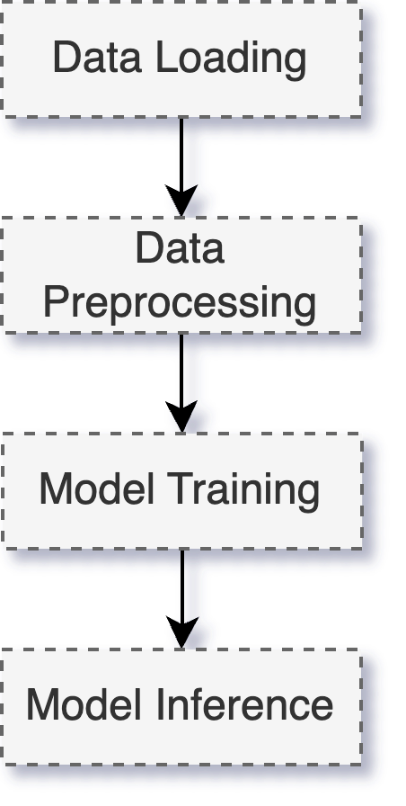
Augmentation, Normalization
Optimizer, Learning rate,
Number of layers, Type of layer
Notes:
Hyperparameter optimization is about findining the optimal configuration of a learning workflow.
A learning workflow can generally be summurized by the follow sequence of steps starting by data loading, preprocessing, model training and finally inference.
In such a workflow many things can be configured. This configuration is sometimes directly exposed but not always. For example we can select the augmentation or normalization policy for preprocessing. We can select the optimizer and the learning rate for the training of a deep neural network. We can also select the architecture of this neural network by configuring the number and type of layers.

Slide 4
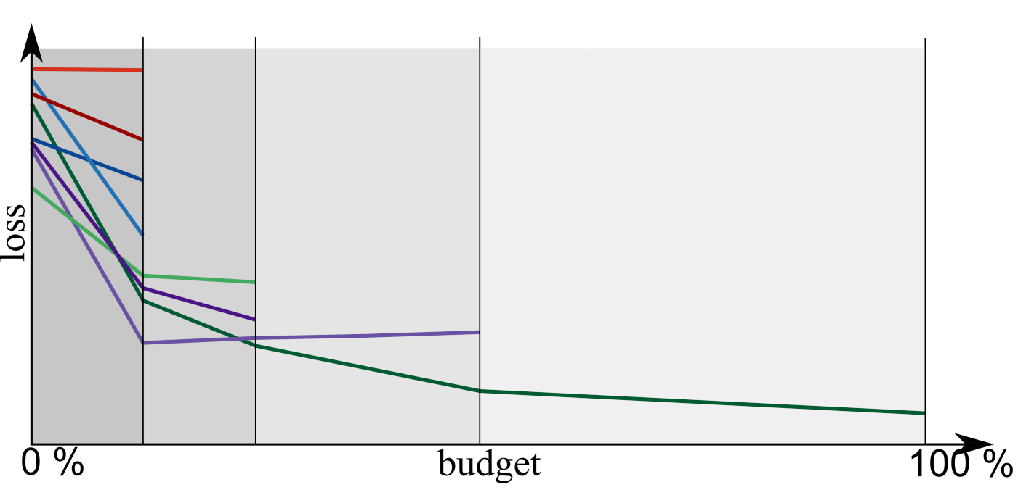
Multi-Fidelity Example with Successive Halving
From: https://amueller.github.io/aml/04-model-evaluation/parameter_tuning_automl.html#successive-halving-different-example
Notes:
In the case of multi-fidelity hyperparameter optimization, we want to select the optimal configuration of the learning workflow without having to train each trial at the maximum.
The idea is to observe the “learning curves” of evaluated configurations such as display in this figure and based on the observation of current performance at lower budgets we decide to continue or stop the training.
A basic method for doing this which only considers local information is “early stopping”.
Now in this figure I am shwoing an example of Successive halving which decides to only continue training the top ranked models at different predefined anchors budgets.
Now a weakness of this method is to not be able to consider neural networks which starts slow and performe better later. A bit like Usain Bolt in a 100 m race where he use to have a larger inertia at the beginning and reached his peak speed later.
I am displaying such case with the blue curve which was stopped but could in principle be better at the end.

Slide 5
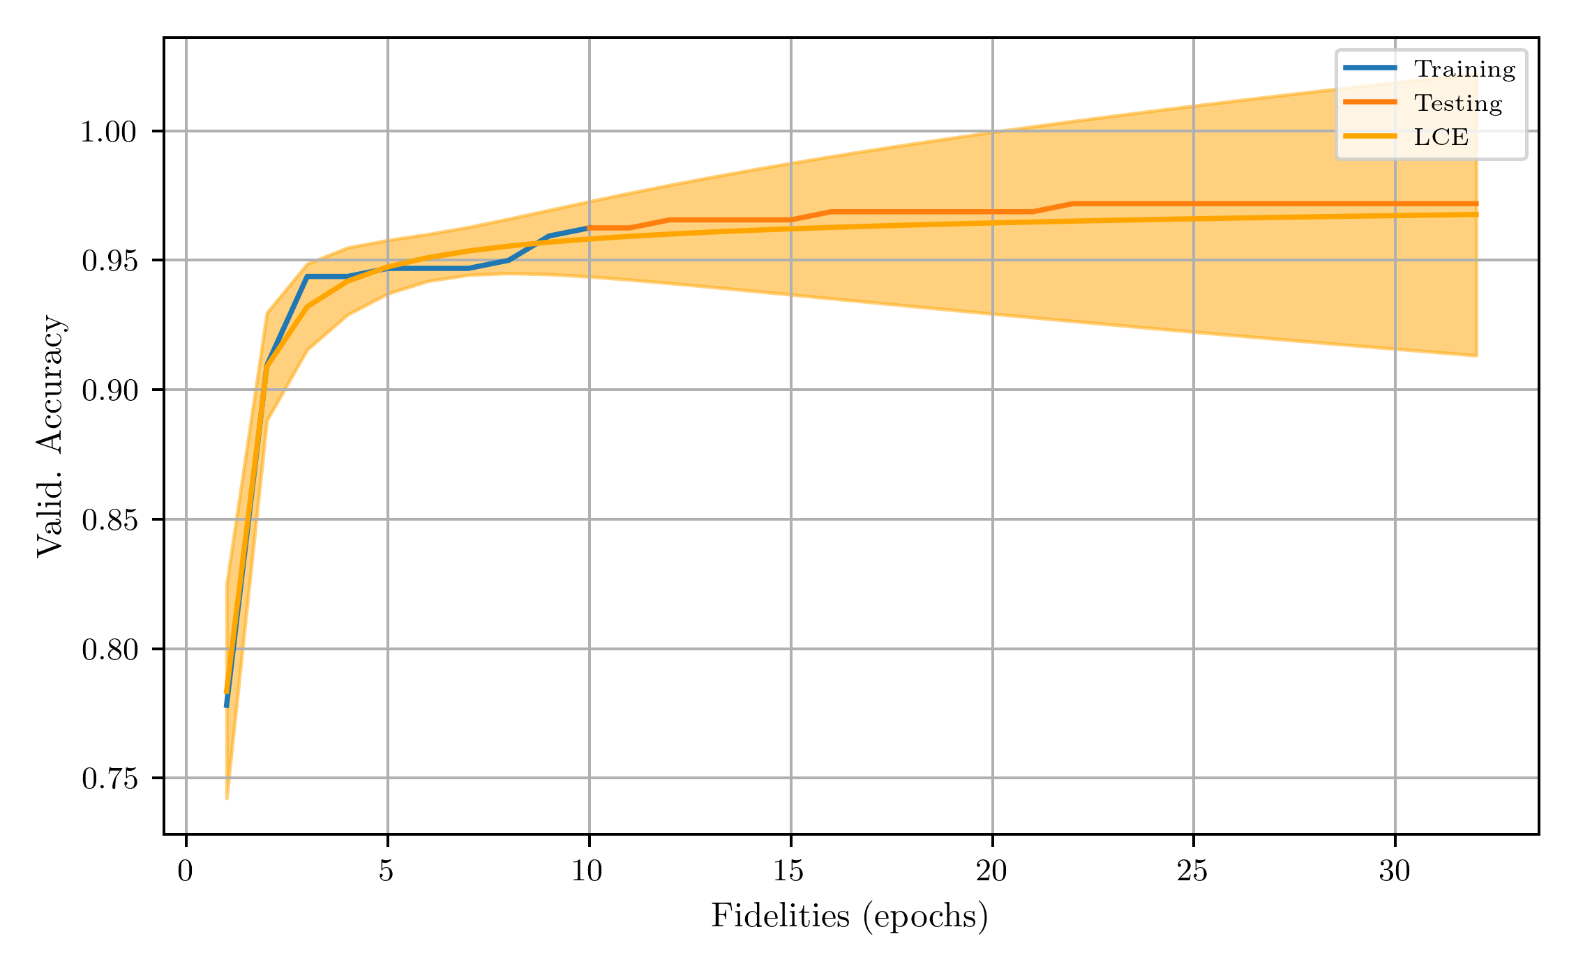
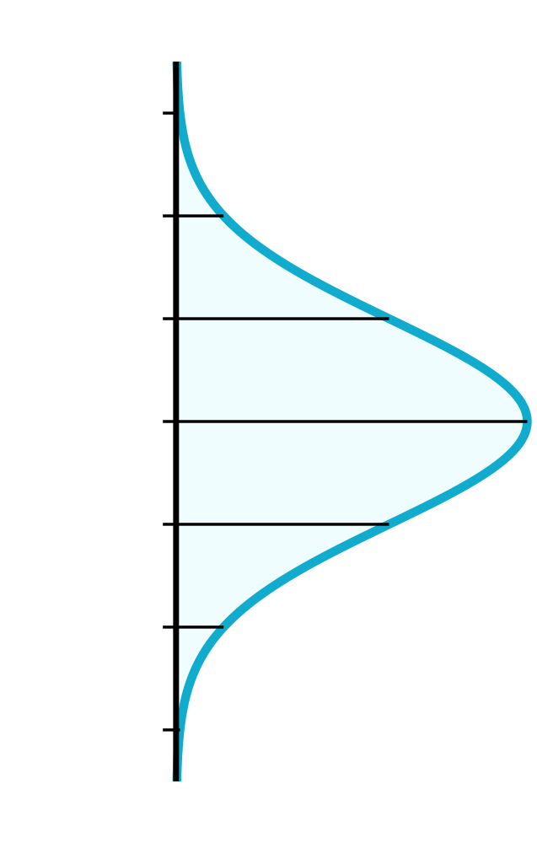
Learning Curve Extrapolation (LCE)
Probability of
Performing Worse
Observation
Notes:
To solve such problem people have suggested to use learning curve model in order to predict the future based on early observation. Even better, we can use probabilistic models which is exactly what we were interested in.
In this case we predict the probability of performing worse than the best observed at maximum budget.
We noticed that methods available in the litterature were not robust and could have failure cases so we worked on developing a ”simplified” but more “robust” version of this method.

Slide 6
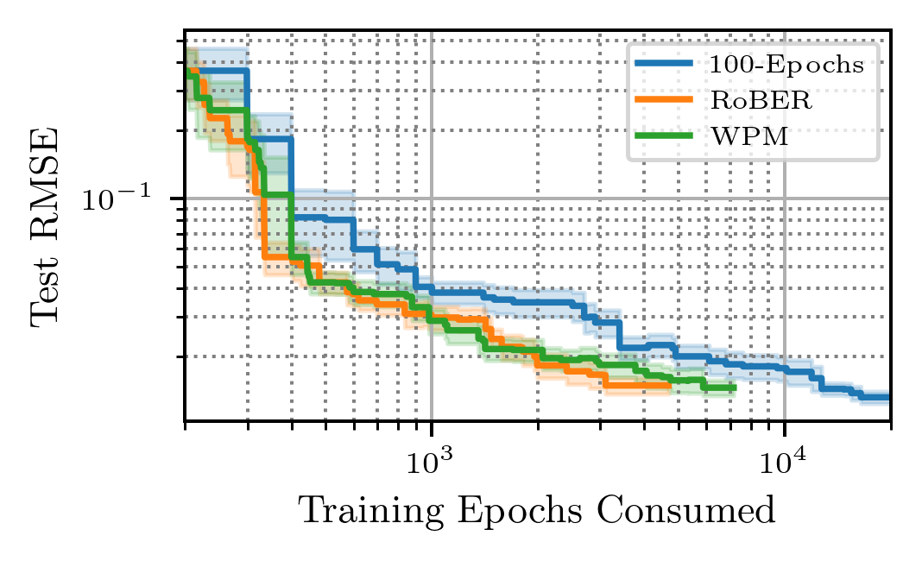
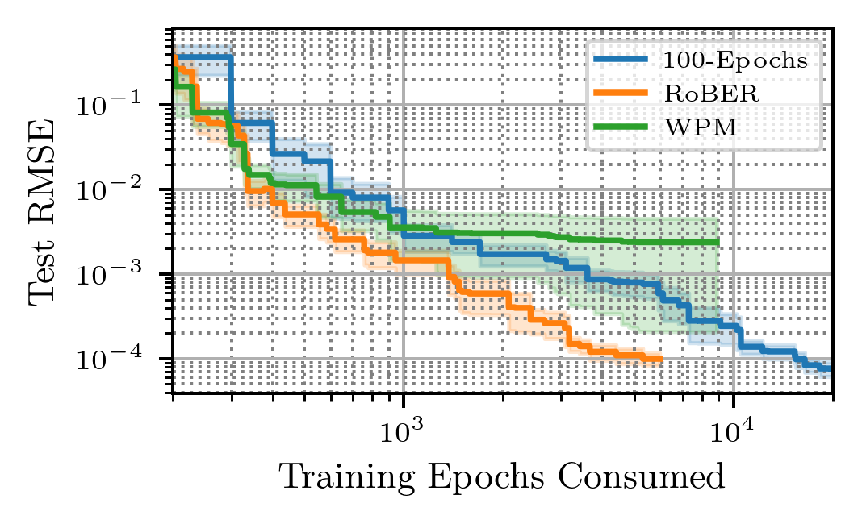
RoBER versus Weighted Prob. Mixture
FAILURE
SUCCESS
Notes:
Here is an example set of results.
Our method is called RoBER and we compare against WPM (weighted probabilistic mixture) which is the learning curve extrapolation method we want to improve and the 100-Epochs is the baseline using “maximum” budget for each triad configuration. It is important to understand to 100—Epochs has “full information” and can be beaten only in an overfitting case (not the case here).
RoBER and WPM are perfoming very similarly on this first dataset. Now on a different dataset we can see the dramatic failure of WPM while RoBER remains efficient.
Our result extended to other benchmarks so at this point we thought we were successful…

Slide 7
Baselines for Budget
Bounds on budget
“Training Steps”
Minimum Number of
Training Steps
Maximum Number of
Training Steps
1-Epoch
100-Epoch
Notes:
But…. We continued and carefully considered what would be the edge cases baseline to test in our testing.
In our previous test we considered only the MAXIMUM budget with 100 epochs.
Now we also wanted to consider the other bound we MINIMUM budget with 1 epoch. We thought that it would be much less efficient of course. But observing the performance loss would still be interesting…

Slide 8
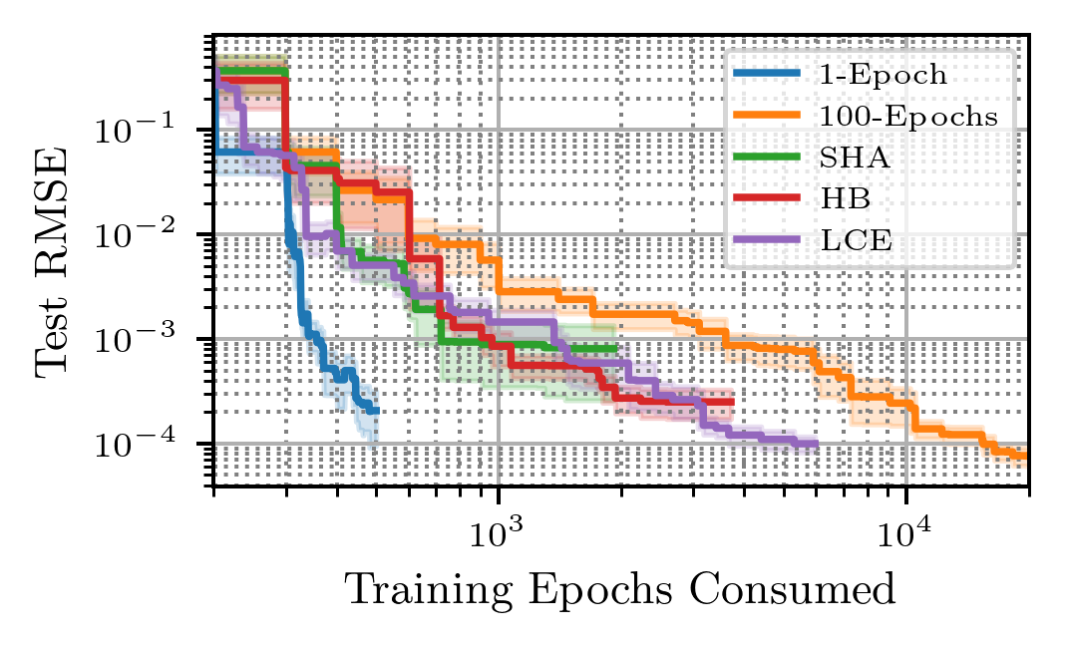
Notes:
Here is our negative result.
100-Epochs is in orange consumes the maximal budget.
Successive Halving (SHA) continue training only top performing models is in green.
HB in red for Hyperband is a version of Successive halving that is robust to noise.
LCE is for learning curve extrapolation and corresponds to our method.
Finally the blue method 1-epoch consuming minimal budget performed suprisingly well consuming consuming significantly less budget than any other method. While being very simple… now we wanted to understand why this was happening.

Slide 9
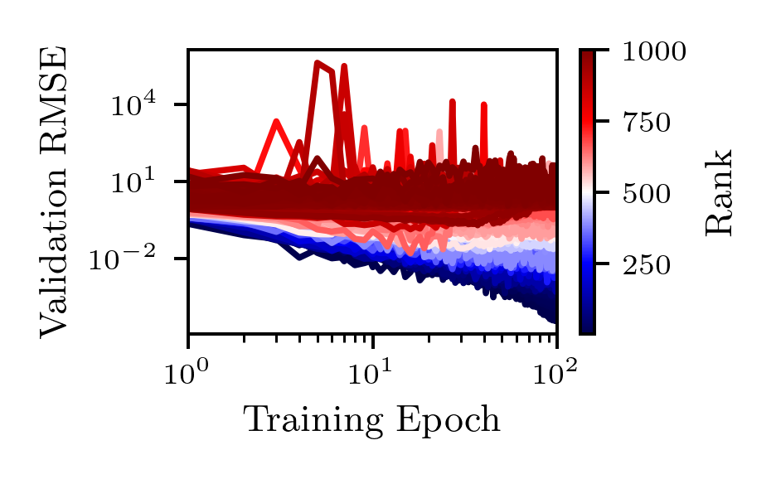
WINNERS
Notes:
We sampled 1,000 random configurations and plotted their learning curve colored their rank at maximum budget.
We see winners in dark blue and loosers in dark red.
From this we understand why 1-Epoch is efficient. Winners have dominant learning curves from the very start.
And this is what we decided to publish eventhough the big part of the work was done on developing our learning curve extrapolation method.

Slide 10

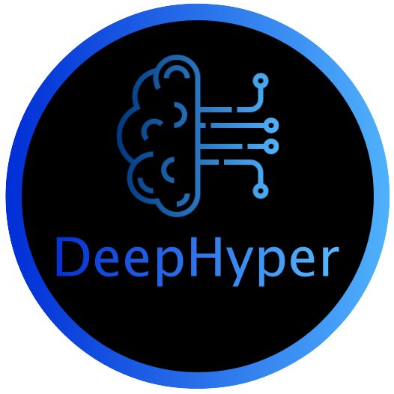
Low fidelity evaluations
“1-Epoch”
can be accurate predictors for model-selection.
Paper
Software
Notes:
The key message of this presentation is to always select carefully our baseline and specifically edge cases that are often easy to implement.
In our case it was about understanding that low fidelity evaluations can be accurate predictors for model-selection.
The paper and software used for these experiments can be retrived by scaning the following QR codes.
Thank you.

Slide 11
END – BACKUP SLIDES
⚠️

Slide 12
Notes:
My research is supervised by two scientists specialized in Machine Learning and HPC.
Isabelle GUYON is the thesis director, professor at Université Paris-Saclay & Research Director at Google.
Prasanna BALAPRAKASH is the thesis co-supervisor, Director of AI programs and Distinguished R&D Staff Scientist at Oak Ridge National Laboratory.

